Slide 1
MY FullStack First Project
INVENTORY AND LOGISTIC MANAGEMENT SYSTEM

Slide 2
INTRODUCTION
As a learner, I’m trying to make a modern inventory management System Project. This Inventory system helps to solve product inventory and management.

Slide 3
PROJECT OVERVIEW
The main functionality of the project is
Inventory management: tracking stock, stock levels, and product details. Where you can find all solution dynamically. You can do everything from adding products to adding to the war house dynamically

Slide 4
Technology Stack
Backend (Spring Boot)
Frontend (Angular)
Database (MySQL):\

Slide 5
Future Enhancements
In my project A's billing system works smoothly, and trying to focused on automating it to reflect real-world billing operations.

Slide 6
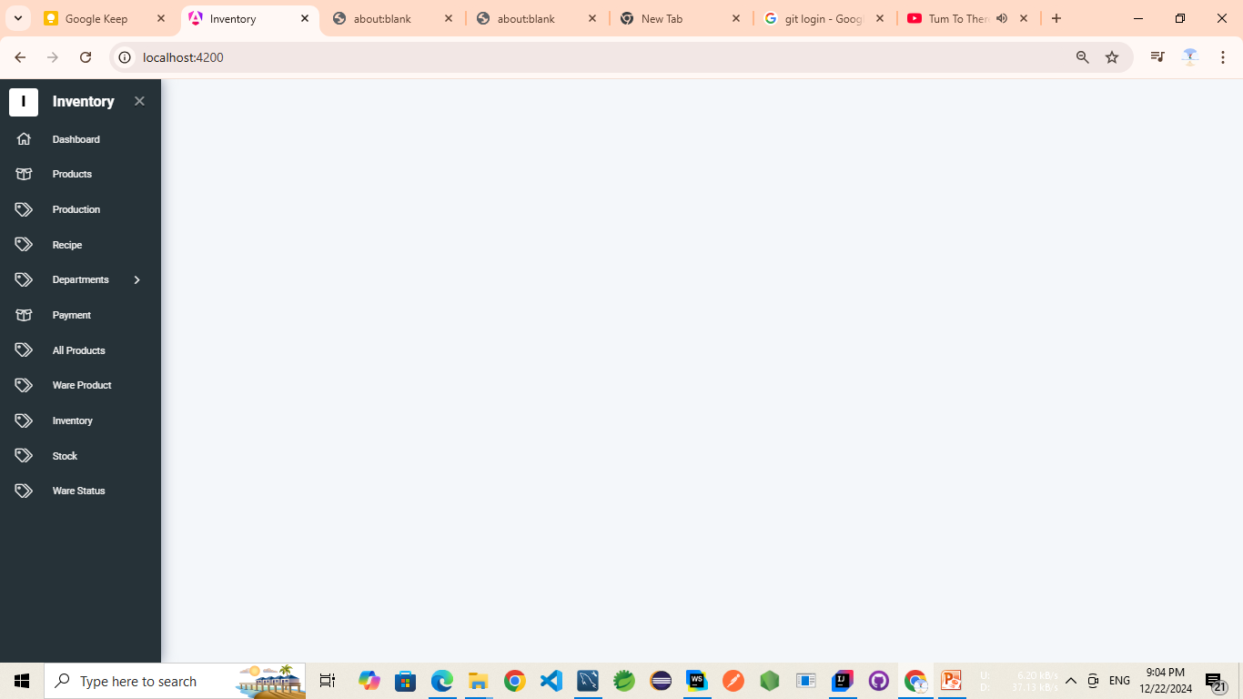
MO

Slide 7
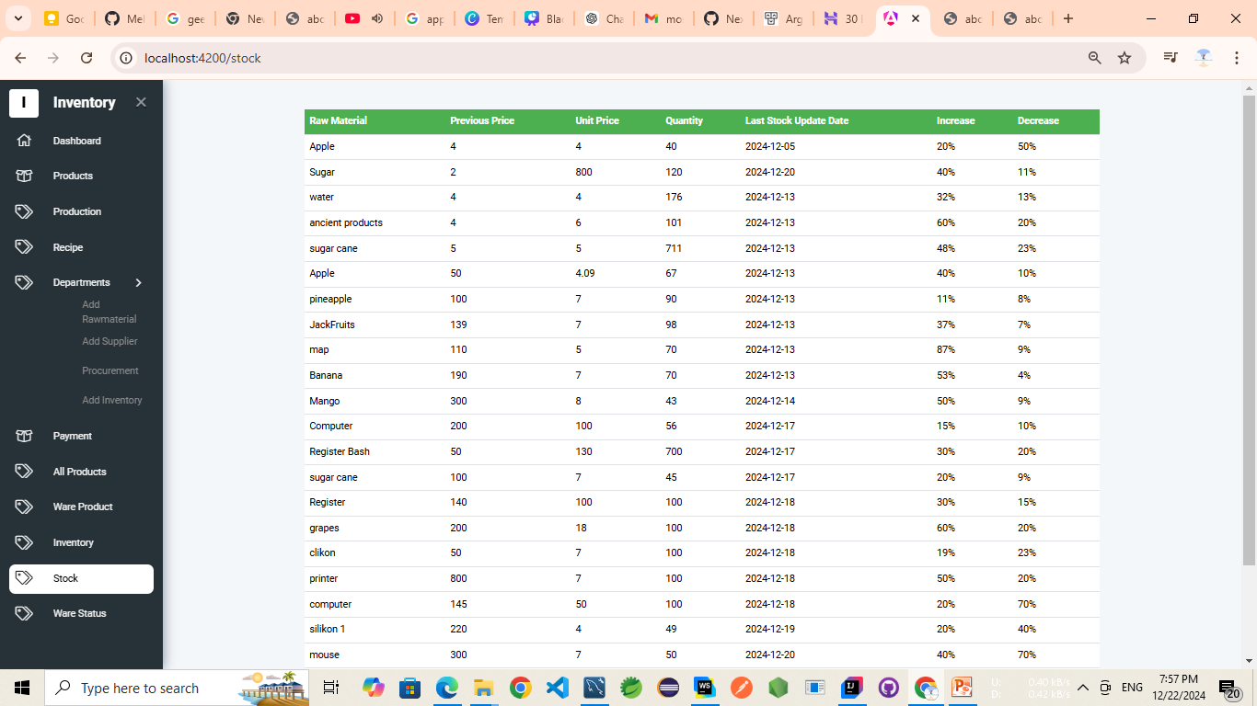

Slide 8
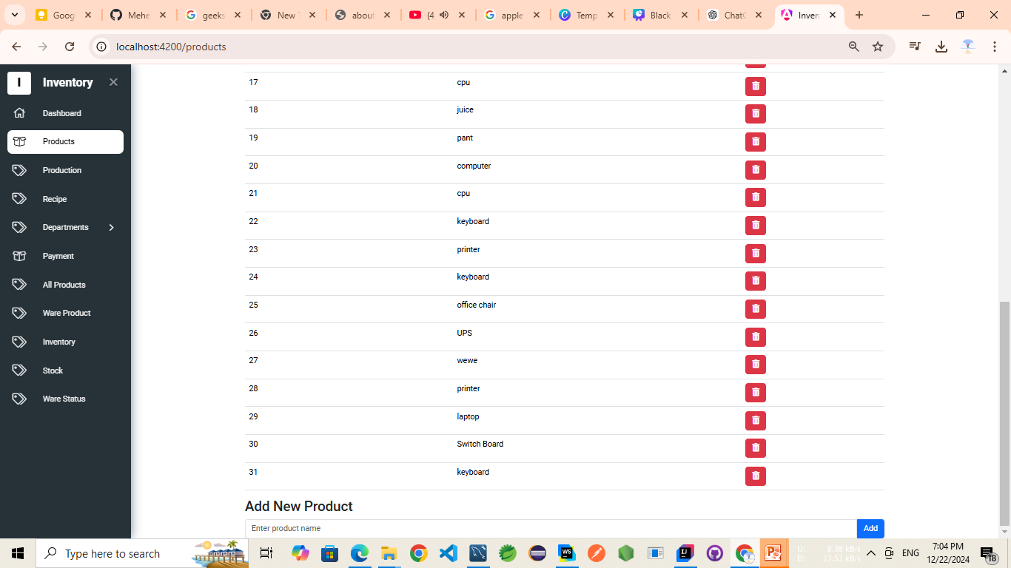

Slide 9
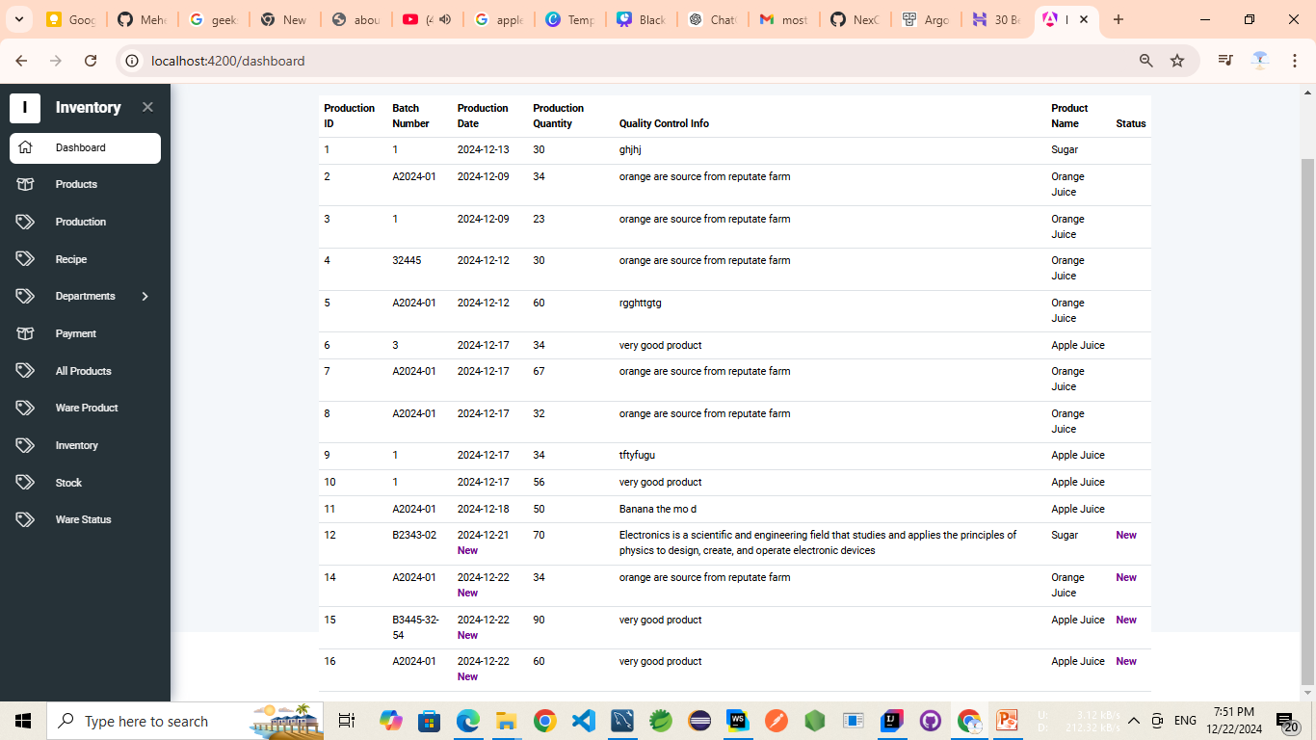

Slide 10
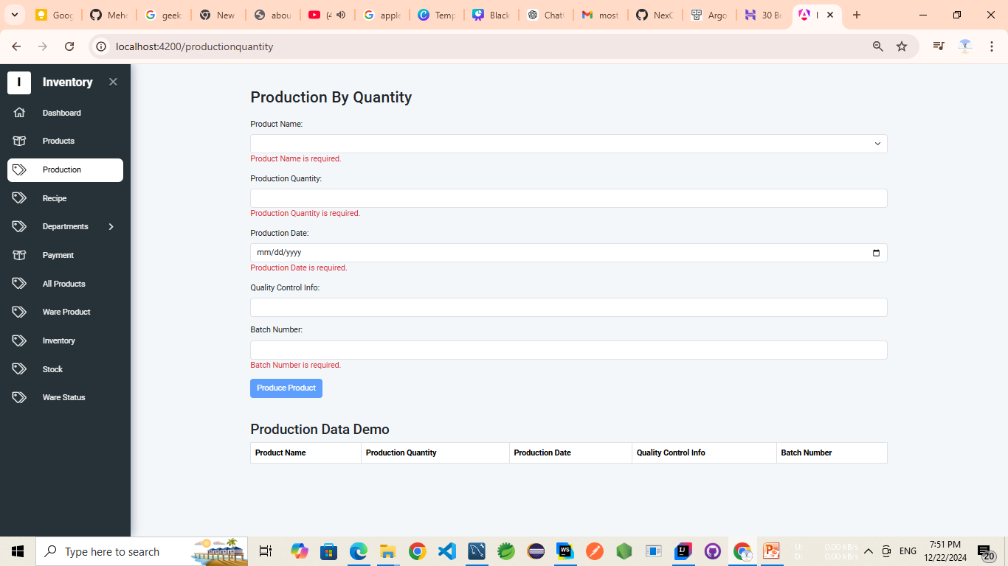

Slide 11
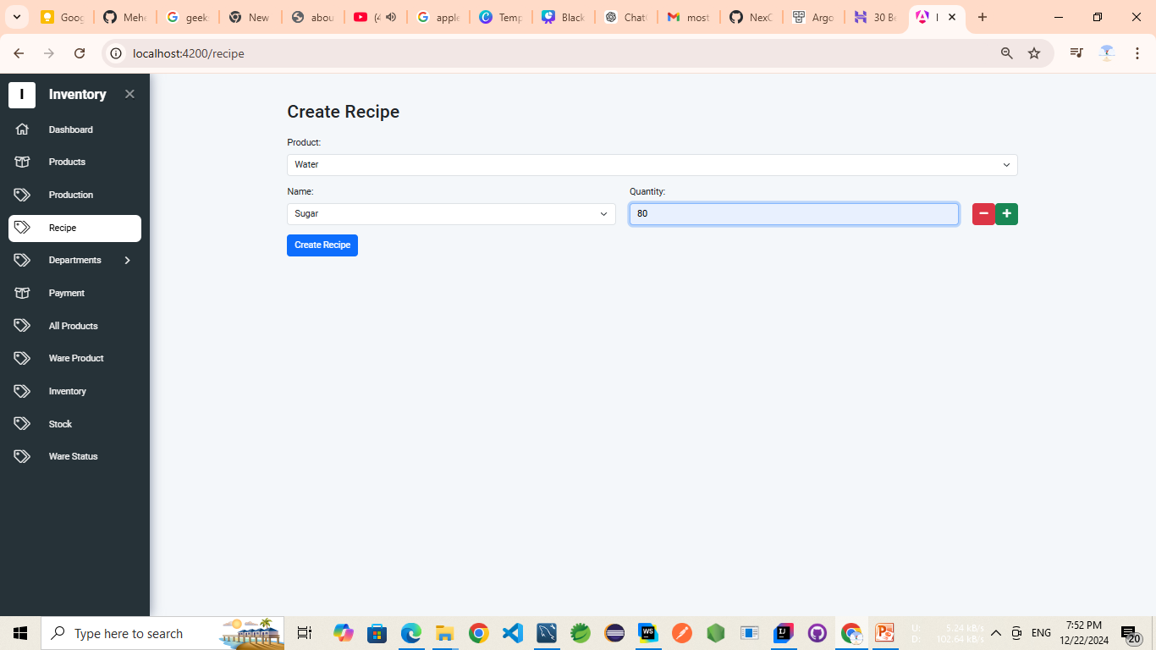

Slide 12
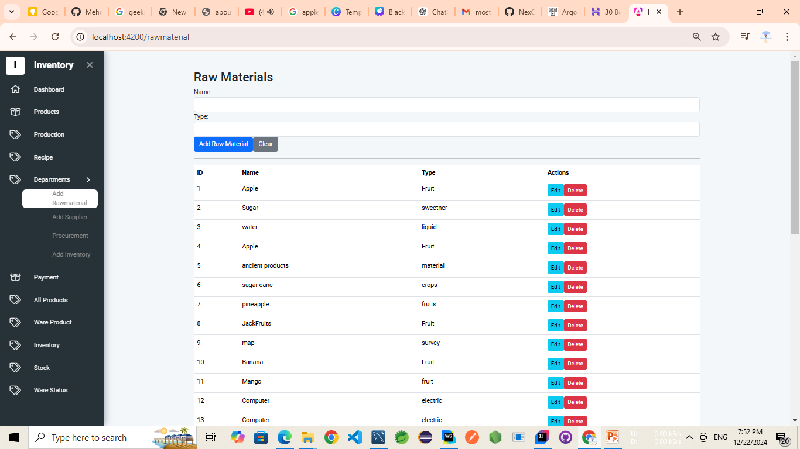

Slide 14
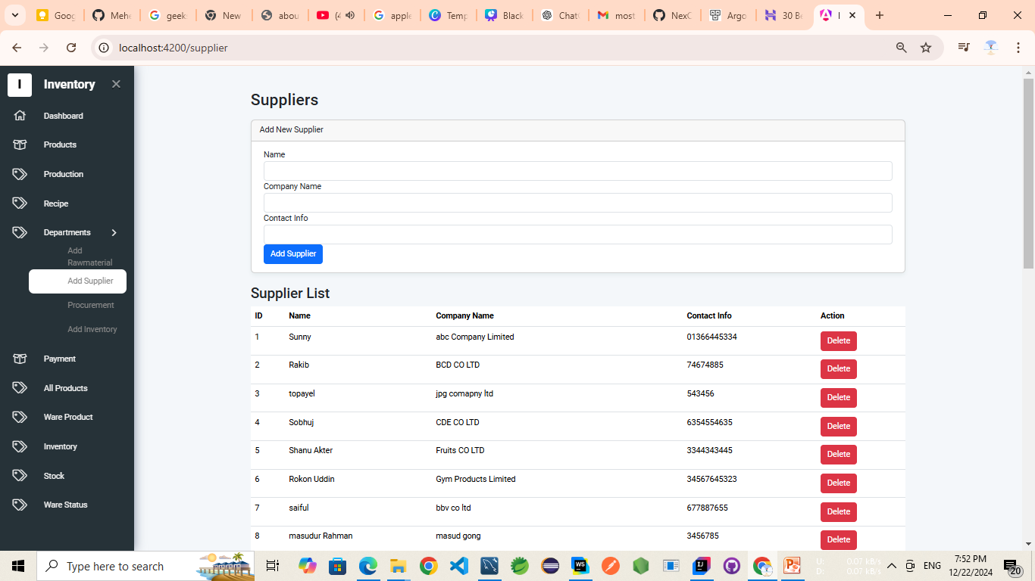

Slide 15
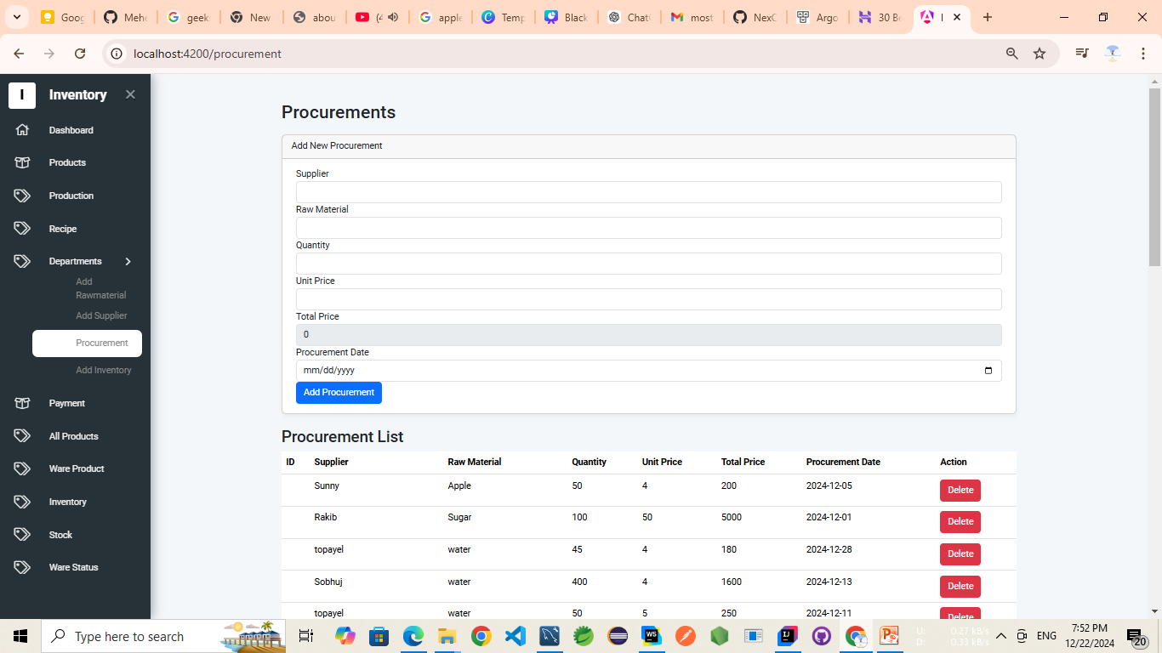

Slide 16
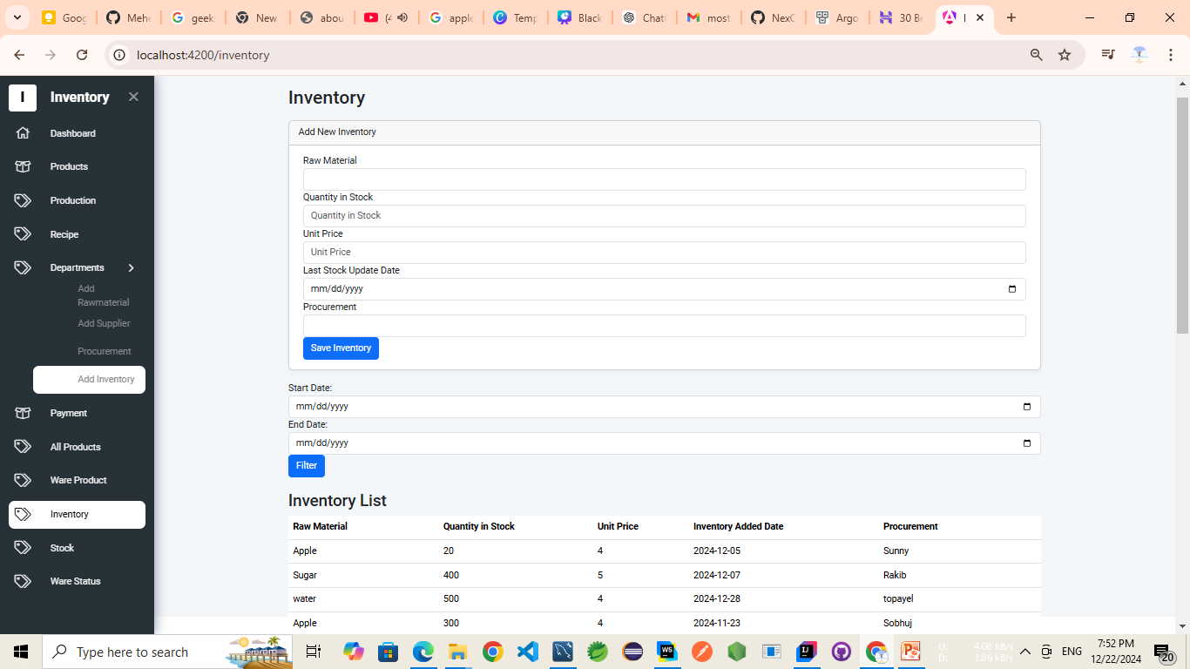

Slide 17
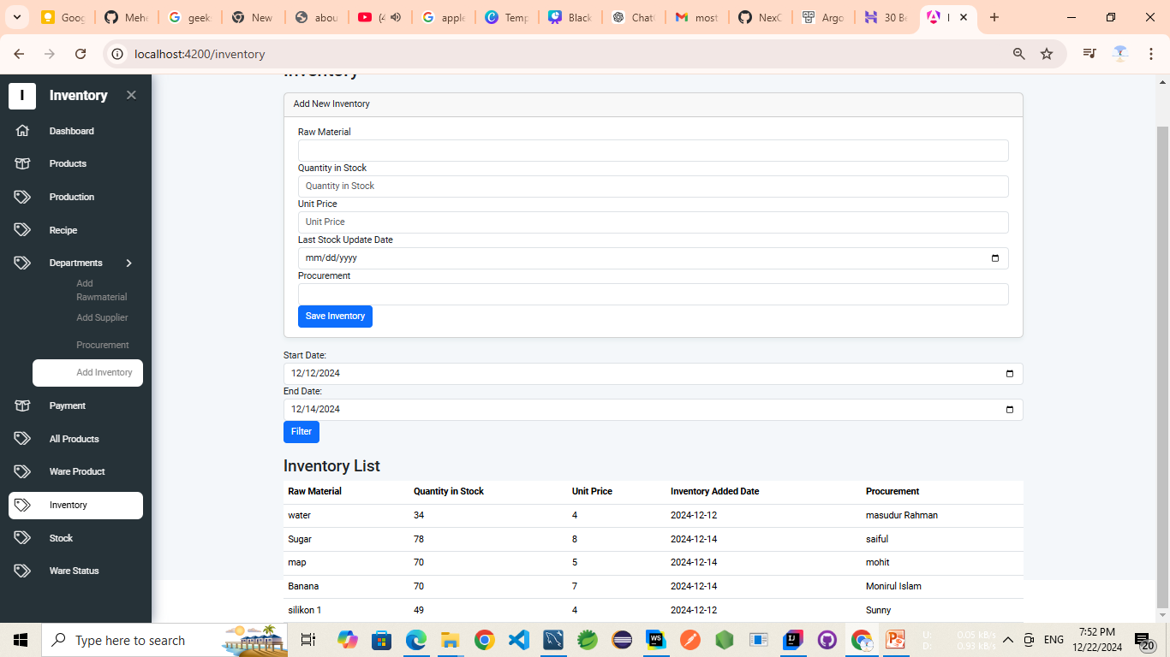

Slide 18
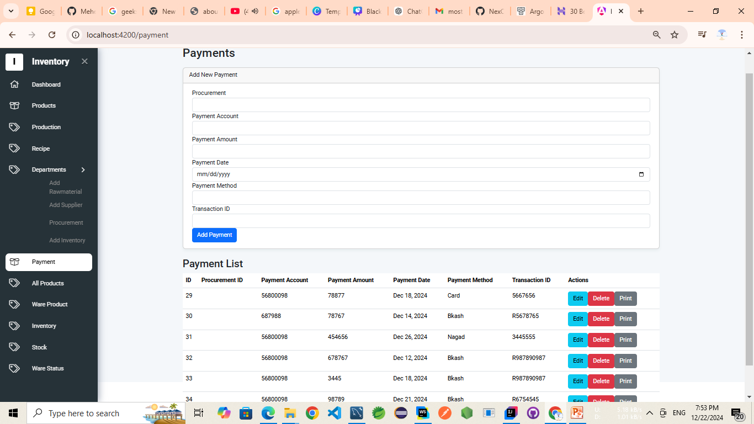

Slide 19
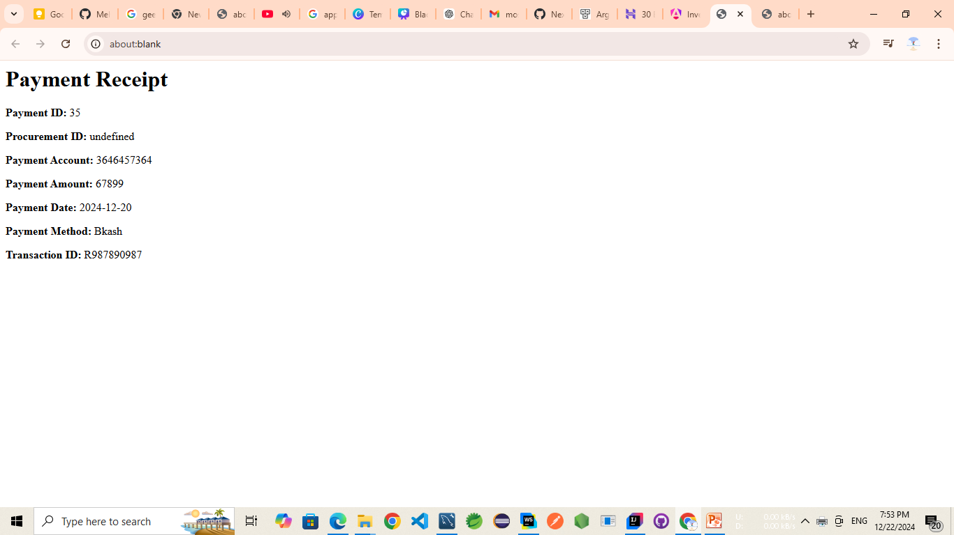

Slide 20
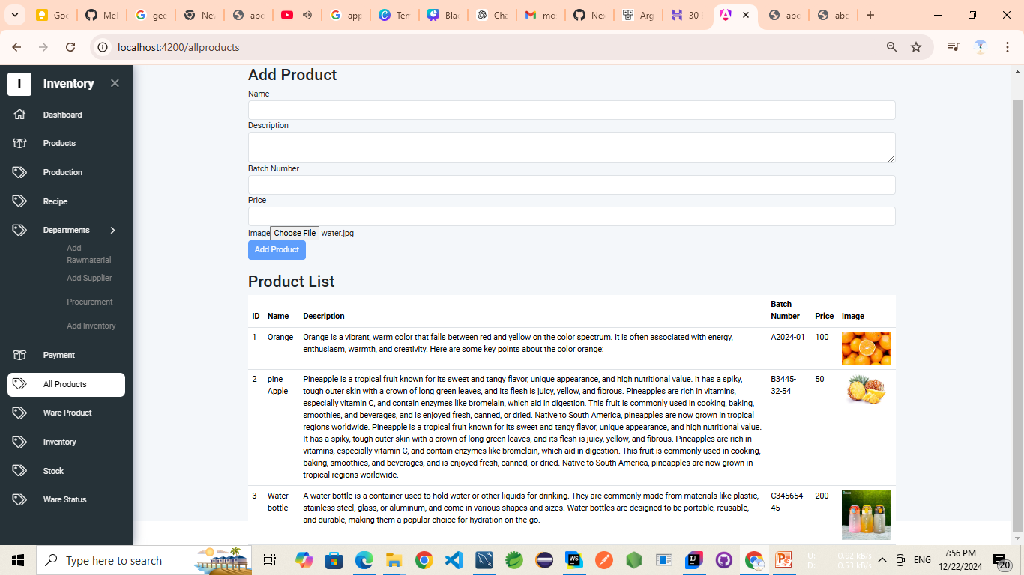

Slide 21
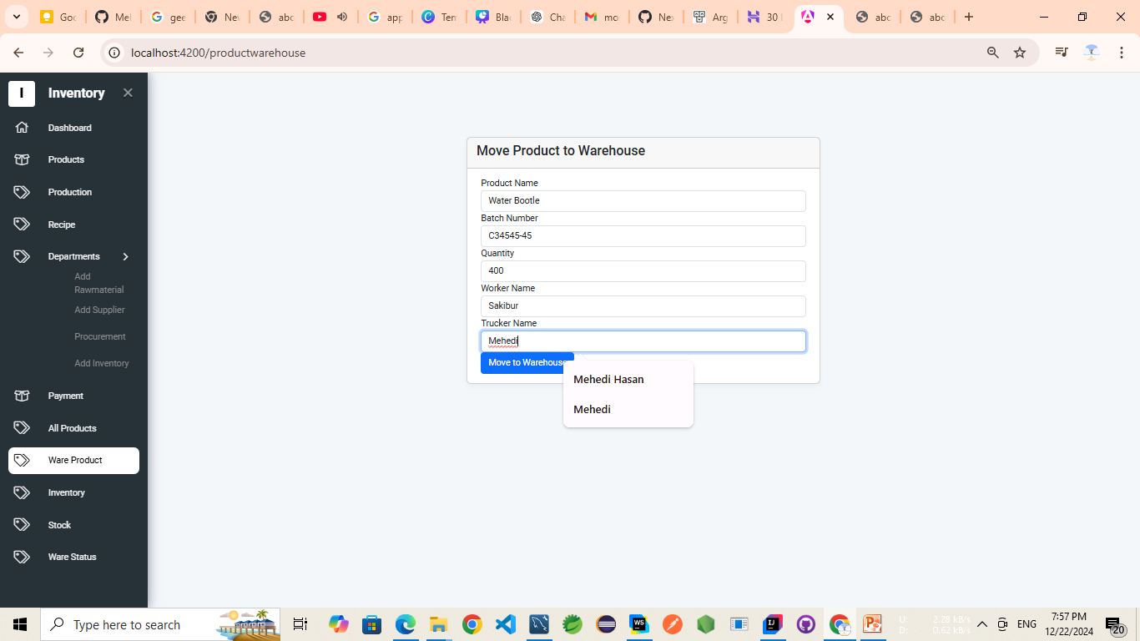

Slide 22
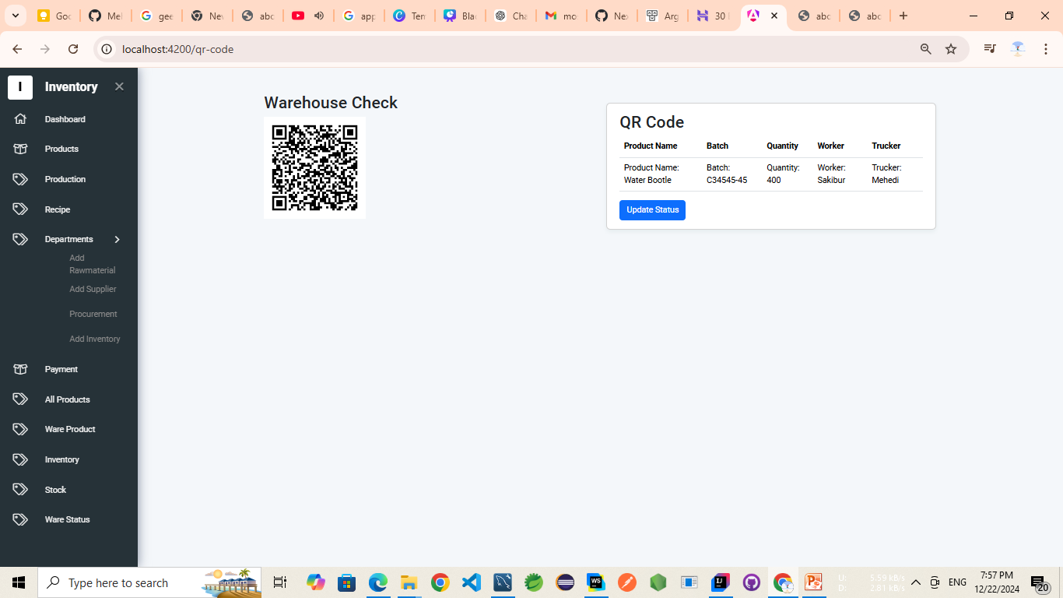

Slide 23
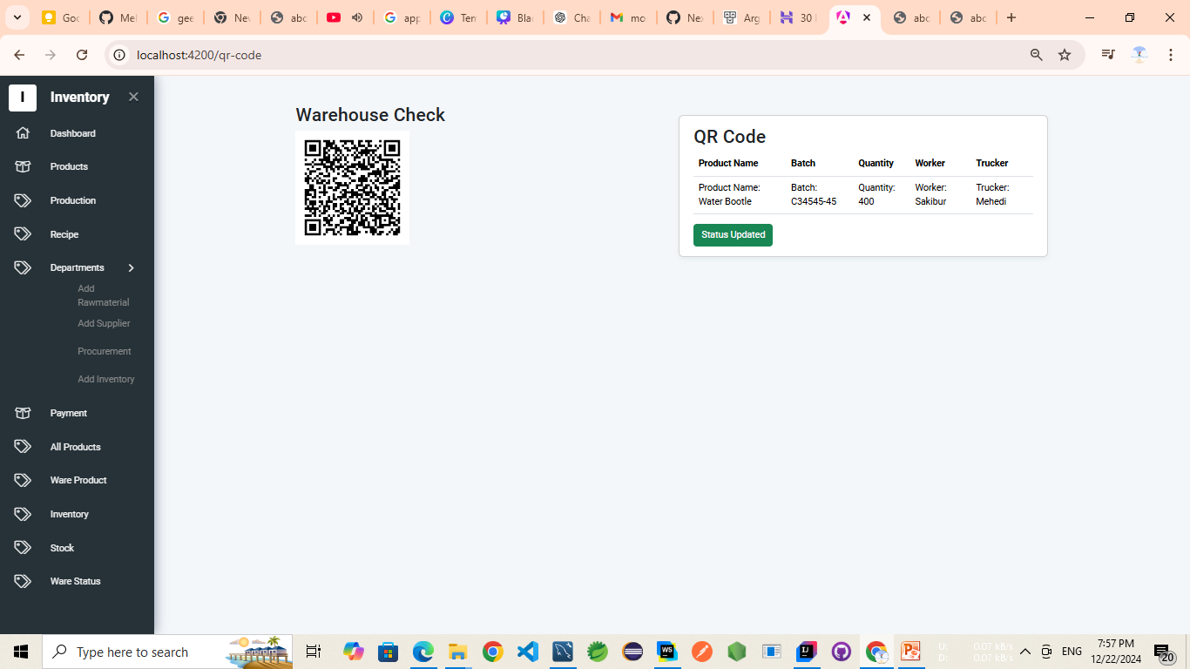

Slide 24
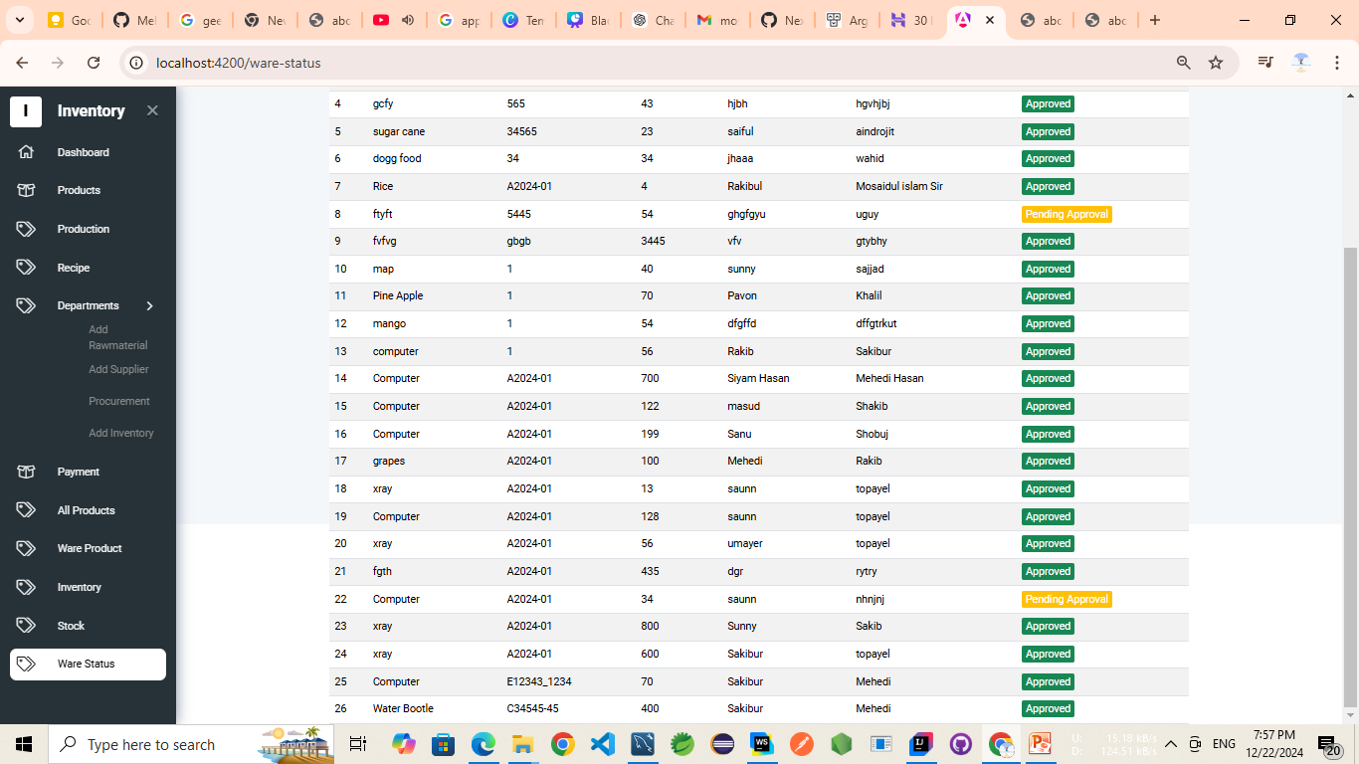

Slide 25
THANK YOU SO MUCH

